Slide 1

Introduction to software engineering Anoud shaikh

Slide 2
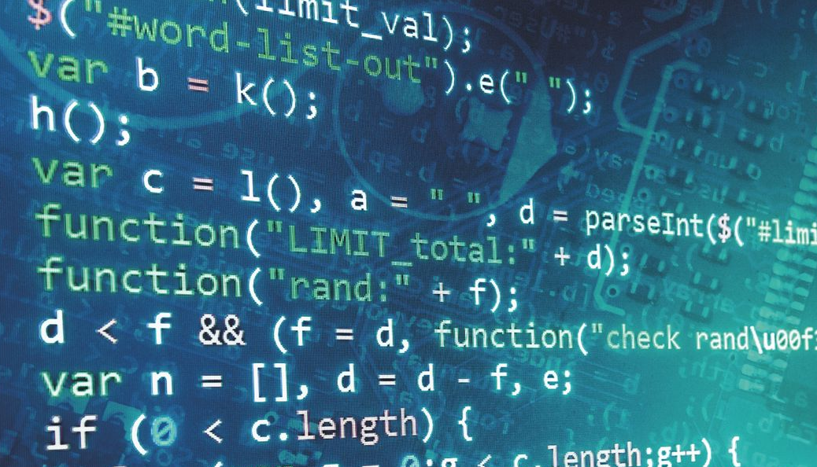
WHAT IS SOFTWARE ENGINEERING?

Slide 3
Definition:
Software engineering is an engineering branch associated with development of software product using well-defined scientific principles, methods and procedures.
The outcome of software engineering is an efficient and reliable software product.

Slide 4

Summary :
Software engineering is a branch of computer science, which uses well-defined engineering concepts required to produce efficient, durable, scalable, in-budget and on-time software products.

Slide 5
Software Engineering (contd.)
IEEE defines software engineering as:
“ The application of a systematic, disciplined, quantifiable approach to the development, operation and maintenance of software; that is, the application of engineering to software.”

Slide 6
Software Engineering (contd.)
Fritz Bauer, a German computer scientist, defines software engineering as:
“Software engineering is the establishment and use of sound engineering principles in order to obtain economically software that is reliable and work efficiently on real machines.”

Slide 7
What is Software?
Software is a collection of instructions and data that tell a computer how to work.
Executable programming code.
Intangible(unable to be touched; not having physical presence).
The product that software professionals build and then support over the long term.

Slide 8
What is Software? (contd.)
Software encompasses:
Instructions
Data structures (Store + Manipulation)
Documentation (Use + Operation)

Slide 9
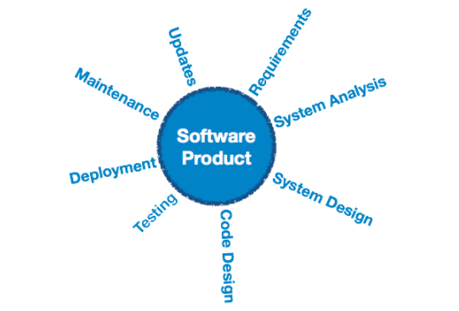
Software Product

Slide 10
Software Products
There are two main types:
Generic Products
Stand-alone systems that are marketed and sold to any customer who wishes to buy them.
Example: appointments systems for dentists
Customized Products
Software that is commissioned by a specific customer to meet their own needs
Example: traffic monitoring systems

Slide 11
Why Software is Important?
The economies of ALL developed nations are dependent on software.
More and more systems are software controlled
Transportation
Medical
Telecommunications
Military
Industrial
Entertainment

Slide 12
Importance of Software Engineering
More and more individuals and society rely on advanced software systems.
It is cheaper to use Software Engineering methods in the long run.
It becomes more important as time goes on – if something breaks within your application portfolio, a quick, efficient, and effective fix needs to happen as soon as possible.
Therefore, we need to be able to produce reliable and trustworthy systems economically and quickly.

Slide 13
Importance of Software Engineering
How you approach software engineering is an important part of how your engineers will work – do you want to develop software for the needs of the users? Do you want to develop software that runs devices and controls your networks? Do you want software that does a combination of the two?
Into the future, there may be even more options and those that invest in software engineering now will reap the benefits for years to come.

Slide 14
Cost Estimate in Software Engineering
Cost estimation in software engineering is typically concerned with the financial spend on the effort to develop and test the software.
This can also include requirements review, maintenance, training, managing and buying extra equipment, servers and software. Many methods have been developed for estimating software costs for a given project.

Slide 15
Software Costs
Software costs often dominate computer system costs.
In other words, the costs of software on a PC are often greater than the hardware cost.
Software costs more to maintain than it does to develop.

Slide 16
Software Costs (contd.)
Software engineering is concerned with cost-effective software development.

Slide 17
Essential attributes of good software
1. Functionality: A good software must be able to do what it was designed to do. The software requirements must guide the design and implementation of the software.
2. Usability: The software must be usable; the users must not find it difficult to figure out how a good software works. A good software is user-centered and user-friendly.
3. Efficiency: Efficiency means that perform it's operations with minimal time and processing power. A good software uses the least amount of processing power and memory needed to achieve the desired result.
4. Maintainability: A good software must evolve with changing requirements.
5. Security: A good software must be secure. It should not cause physical or economic damage in the event of a system failure. Unauthorized users must not be allowed access to the system.
6. Reliability: A reliable system will rarely fail, and even when it does fail, there are recovery mechanisms in the software to recover from the failure with minimal losses.

Slide 18
Software
System software (designed to run computer’s hardware and application programs. Example: windows, chrome, iOS).
Application Software ( Application software is a program or group of programs designed for end users. Example:. Database programs, spreadsheets, Editors.)
Engineering/ scientific software (Example: MATLAB, ORCAD, AUTOCAD)
Embedded software (is a programming chip in an embedded device to control its functions. Example: GPS devices, modern smartwatches).
Product-line software
Web Apps
AI

Slide 19
Software – New Categories
Open world computing
Netsourcing
Open source
Data mining
Grid computing
Cognitive machines
Software for nanotechnologies

Slide 20
Software Project Management
Software Project Management (SPM) is a proper way of planning and leading software projects.
It is a part of project management in which software projects are planned, implemented, monitored, and controlled.
Software project management has wider scope than software engineering process as it involves communication, pre and post delivery support etc.

Slide 21
Need for Software Project Management
Software is a non-physical product. Software development is a new stream in business and there is very little experience in building software products. Most of the software products are made to fit clients’ requirements. The most important is that the basic technology changes and advances so frequently and rapidly that experience of one product may not be applied to the other one. Such type of business and environmental constraints increase risk in software development hence it is essential to manage software projects efficiently. It is necessary for an organization to deliver quality products, keep the cost within the client’s budget constrain and deliver the project as per schedule. Hence in order, software project management is necessary to incorporate user requirements along with budget and time constraints.

Slide 22
Principles that guide Practice
Software Practice is a broad array of principles, concepts, methods and tools that you must consider as software is planned and developed.
Software Process provides everyone with a road map for getting to a successful destination.
Practice provides you with the details you will need to drive along the road. Where the bridges, the roadblocks, and the forks are located?

Slide 23
Principles Overview
Core Principles
Principles for Software Process
Principles for Software Practice
Principles for each Activity
Principles for Communication
Principles for Planning
Principles for Modeling
Requirement
Design
Principles for Construction
Coding
Testing
Principles for Deployment

Slide 24
Principles that Guide Process
Principle 1:
Be agile (Easy to move)
Principle 2:
Focus on quality at every step (fitness of purpose, customer satisfaction)
Principle 3:
Be ready to adapt (Switch)
Principle 4:
Build on effective team (Good output, collection)
Principle 5:
Establish mechanisms for communication and coordination (fit and available for use ).
Principle 6:
Manage Change
Principle 7:
Assess Risk (Probability of loss).
Principle 8:
Create work products that provide value for others

Slide 25
Principles that Guide Practice
Principle 1:” Divide and conquer”. Stated in a more technical manner, analysis and design should always emphasize separation of concerns (SoC).
Principle 2: . “Understand the use of abstraction”. At its core, an abstraction is a simplification of some complex element of a system used to communicate meaning in a single phrase.
Principle 3: “Strive for consistency”. A familiar context makes software easier to use. Stick with same notation.
Principle 4: “Focus on the transfer of information”. Pay special attention to the analysis, design, construction, and testing of interfaces which make the transfer of information.

Slide 26
Principles that Guide Practice (contd.)
Principle 5: . “Build software that exhibits effective modularity”. Separation of concerns (Principle #1) establishes a philosophy for software. Modularity provides a mechanism for realizing the philosophy (Well-defined components).
Principle 6: “Look for patterns”. Brad Appleton [App00] suggests that: “The goal of patterns within the software community is to create a body of literature to help software developers resolve recurring problems encountered throughout all of software development.
Principle 7: “When possible, represent the problem and its solution from a number of different perspectives”. This will eliminate possible errors.
Principle 8: Remember that someone will maintain the software

Slide 27
Communication Principles
Principle #1. Listen. Try to focus on the speaker’s words, rather than formulating your response to those words.
Principle # 2. Prepare before you communicate. Spend the time to understand the problem before you meet with others.
Principle # 3. Someone should facilitate the activity. Every communication meeting should have a leader (a facilitator) to keep the conversation moving in a productive direction; (2) to mediate any conflict that does occur, and (3) to ensure that other principles are followed.
Principle #4. Face-to-face communication is best. But it usually works better when some other representation of the relevant information is present (like a drawing)

Slide 28
Communication Principles (contd.)
Principle # 5. Take notes and document decisions. Someone participating in the communication should serve as a “recorder” and write down all important points and decisions.
Principle # 6. Strive for collaboration. Collaboration and consensus occur when the collective knowledge of members of the team is combined to describe product.
Principle # 7. Stay focused, modularize your discussion. The more people involved in any communication, the more likely that discussion will bounce from one topic to the next (facilitator’s role).
Principle # 8. If something is unclear, draw a picture.

Slide 29
Communication Principles (contd.)
Principle # 9. (a) Once you agree to something, move on; (b) If you can ’t agree to something, move on; (c) If a feature or function is unclear and cannot be clarified at the moment, move on.
Principle # 10. Negotiation is not a contest or a game. It works best when both parties win. But still will need compromise from both parties.

Slide 30
Planning Principles
Principle #1. Understand the scope of the project. It’ s impossible to use a roadmap if you don’t know where you ’re going. Scope provides the software team with a destination.
Principle #2. Involve the customer in the planning activity. The customer defines priorities and establishes project constraints.
Principle #3. Recognize that planning is iterative. A project plan is never engraved in stone. As work begins, it is very likely that things will change.
Principle #4. Estimate based on what you know. The intent of estimation is to provide an indication of effort, cost, and task duration, based on the team’s current understanding of the work to be done.

Slide 31
Planning Principles (contd.)
Principle #5. Consider risk as you define the plan. If you have identified risks that have high impact and high probability, contingency planning is necessary.
Principle #6. Be realistic. People don’t work 100 percent of every day. They can make mistakes.
Principle #7. Adjust granularity as you define the plan. Granularity refers to the level of detail that is introduced as a project plan is developed. High and low.
Principle #8. Define how you intend to ensure quality. The plan should identify how the software team intends to ensure quality (technical review schedule, pair programming, etc.)

Slide 32
Planning Principles (contd.)
Principle #9. Describe how you intend to accommodate change. Even the best planning can be obviated by uncontrolled change. Have plans for customer requests.
Principle #10. Track the plan frequently and make adjustments as required. Software projects fall behind schedule one day at a time. Therefore, look at the plan daily.

Slide 33
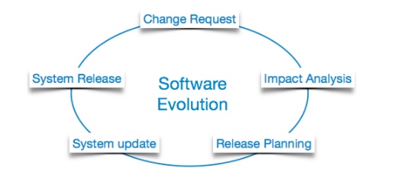
Software Evolution

Slide 34
Software Evolution (contd.)
The process of developing a software product using software engineering principles and methods is referred to as ”software evolution”.
This includes the initial development of software and its maintenance and updates, till desired software product is developed, which satisfies the expected requirements.

Slide 35

Software Evolution (contd.)
Evolution starts from the requirement gathering process.

Slide 36
Software Evolution (contd.)
After which developers create a prototype of the intended software and show it to the users to get their feedback at the early stage of software product development.
The users suggest changes, on which several consecutive updates and maintenance keep on changing too.
This process changes to the original software, till the desired software is accomplished.

Slide 37
Software Evolution (contd.)
Even after the user has desired software in hand, the advancing technology and the changing requirements force the software product to change accordingly.
Re-creating software from scratch and to go one-on-one with requirement is not feasible.
The only feasible and economical solution is to update the existing software so that it matches the latest requirements.

Slide 38
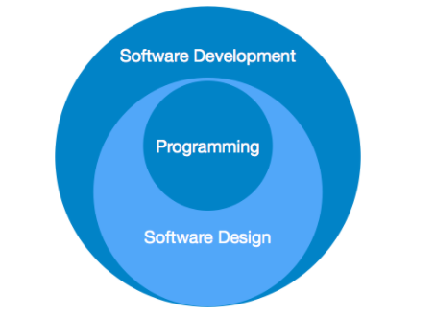
Software Paradigms
Software paradigms refer to the methods and steps, which are taken while designing the software.

Slide 39
Software Paradigms (contd.)
Programming paradigm is a subset of Software design paradigm which is further a subset of Software development paradigm.

Slide 40
Software Development Paradigm
This Paradigm is known as software engineering paradigms where all the engineering concepts pertaining to the development of software are applied.
It includes various researches and requirement gathering which helps the software product to build.
It consists of –
Requirement gathering
Software design
Programming

Slide 41
Software Design Paradigm
This paradigm is a part of Software Development and includes –
Design
Maintenance
Programming

Slide 42
Programming Paradigm
This paradigm is related closely to programming aspect of software development.
This includes –
Coding
Testing
Integration

Slide 43

Need of Software Engineering

Slide 44
Need of Software Engineering
The need of software engineering arises because of higher rate of change in user requirements and environment on which the software is working.

Slide 45
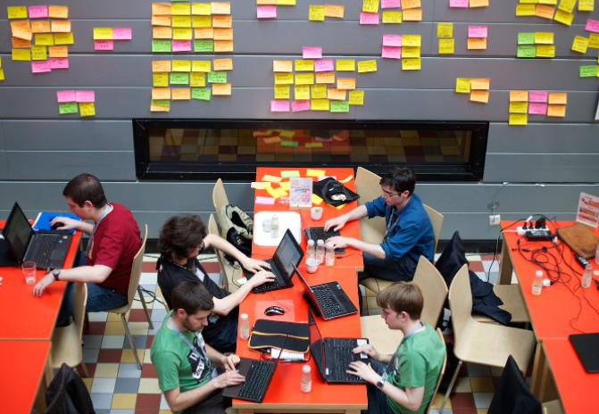
1. Large software
It is easier to build a wall than to a house or building, likewise, as the size of software become large engineering has to step to give it a scientific process.

Slide 46
2. Scalability
If the software process were not based on scientific and engineering concepts, it would be easier to re-create new software than to scale an existing one.

Slide 47


3.Cost
As hardware industry has shown its skills and huge manufacturing has lower down the price of computer and electronic hardware. But the cost of software remains high if proper process is not adapted.

Slide 48
4. Dynamic Nature
The always growing and adapting nature of software hugely depends upon the environment in which user works. If the nature of software is always changing, new enhancements need to be done in the existing one. This is where software engineering plays a good role.

Slide 49
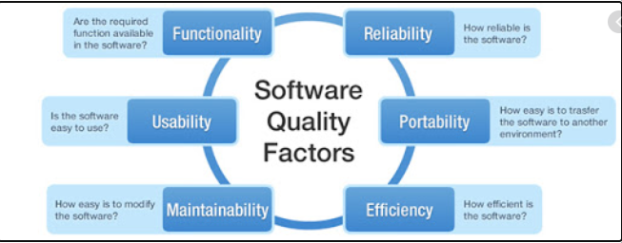
5.Quality Management
Better process of software development provides better and quality software product.

Slide 50
Characteristics of a good Software
A software product can be judged by what it offers and how well it can be used. This software must satisfy on the following grounds:
Operational
Transitional
Maintenance
Well-engineered and crafted software is expected to have the following characteristics:

Slide 51
Operational
Operational : This tells us how well software works in operations. It can be measured on:
Budget
Usability
Efficiency
Correctness
Functionality
Dependability
Security
Safety

Slide 52
Transitional
Transitional: This aspect is important when the software is moved from one platform to another:
Portability
Interoperability
Reusability
Adaptability

Slide 53

Maintenance
Maintenance: This aspect briefs about how well a software has the capabilities to maintain itself in the ever-changing environment:
Modularity
Maintainability
Flexibility
Scalability

Slide 54

Any Questions ?

